Slide 1
Syncav™ CRT
优化CRT的新方案
Notes:
Welcome to the course on SyncAV™ CRT.The new algorithm for optimal CRT.

Slide 2

SyncAV™ CRT是什么？
新算法
以负向AV滞后功能为基础
让医师更加个性化地使用CRT
动态算法可在院外自动更改参数
可与Medtronic的AdaptivCRT™算法同台竞争
软件版本
美国：v.22.0.1
欧洲：v.22.0.2
可用于以下器械
 | 型号名称
CRT-P | Allure Quadra Allure Quadra™ RF Quadra Allure™ Quadra Allure MP™ Quadra Allure MP™ RF
CRT-D | Quadra Assura™ Quadra Assura MP™
Notes:
What is SyncAV™ CRT?
SyncAV™ CRT is a new algorithm that is built upon Negative Hysteresis.The introduction of SyncAV™ CRT replaces Negative Hysteresis in the devices shown in the table on the right.SyncAV™ CRT is available on both CRT-P and CRT-D’s.The algorithm is designed to allow physicians to make CRT more individualized and is dynamic in that it will make parameter adjustments out of clinic.
This feature is intended to directly compete with the Medtronic™ AdaptiveCRT™ algorithm.
SyncAV™ CRT will be available in the software versions displayed by geography.

Slide 3
与AdaptivCRT™算法的竞争
提供AdaptivCRT™算法的竞争方案
竞争背景：Medtronic使用AdaptivCRT™算法作为其Quadripolar CRT-D系统的关键区分功能
AdaptivCRT™算法是根据MDT“优化”CRT而来的算法 - 作为“院外QuickOpt™优化”
非劣效性研究亚组分析的多项临床声明， 并启动了一项大型临床研究“AdaptResponse试验”
MDT通过AdaptivCRT™算法已经在部分客户中受到关注， 但是SyncAV™ CRT算法可与之竞争。
Notes:
AdaptivCRT™ Algorithm is an algorithm to “optimize” CRT from MDT – consider it an “out of clinic QuickOpt™ optimization”
Multiple clinical claims from non-inferiority trial sub-analysis, and have also launched a large clinical study, the AdaptResponse Trial
MDT has gained traction in particular accounts with AdaptivCRT™ algorithm, but we have an algorithm to compete.

Slide 4
为什么选择SyncAV™ crt？
在启用时，SyncAV™ CRT可连续监测患者自身的AV传导间期并在此间期内动态调整CRT参数的变化。
SyncAV™ CRT的亮点
自动测量患者自身AV传导间期
在恒定的心动周期数内，可程控的SyncAV™ CRT Delta值可缩短程控的AV延迟
连续256个心动周期检索窗口
程控步骤简单
与MPP互补
设计用于提供
以患者为基础，更具个性化的CRT程控
根据患者活动程度、心率、传导状态和药物等的变化进行动态调整
Notes:
Why SyncAV™ CRT?
When enabled, SyncAV™ CRT continuously monitors the patient’s intrinsic AV conduction intervals and adjusts CRT parameters to changes in the patient’s conduction.
SyncAV™ CRT performs automatic measurement of intrinsic AV conduction intervals.
The programmable SyncAV™ CRT Delta shortens the programmed AV delays for a set number of cycles
The continuous 256 cycle window searches and adjusts parameters based upon changes in the patient intrinsic AV conduction time
The steps to program SyncAV™ CRT are simple
SyncAV™ CRT is a new tool in the CRT Toolkit that is complimentary to MultiPoint™ pacing

Slide 5
负滞后审查
A_{P}V_{P}
A_{P}V_{S}
A_{P}V_{P}
A_{S}V_{P}
如果自身R波出现，AV延迟缩短256个心动周期
第32个心动周期
175
140
（测量结果）
100
100
A_{P}V_{P}
A_{P}V_{P}
A_{S}V_{P}
程控的A_{S}延迟= 150ms
程控的A_{P}延迟= 175ms
程控的滞后Delta = -40ms
100
175
150
Notes:
Before we can understand how SyncAV™ CRT works, let’s take a moment to review the Negative Hysteresis algorithm.Negative Hysteresis, when activated, causes the device to look for intrinsic ventricular activity that occurs during the Paced or Senses AV delay.If the device detects a V-sense event during the AV delay it subtracts a programmed delta from the measured A-V interval for 32 cycles.If no additional intrinsic V-sense events occur the device would return to the programmed Paced and Senses AV delays.Negative hysteresis was introduced to promote 100% Bi-ventricular pacing.
SyncAV™ CRT builds upon this concept but now extends the search window to 3-cycles.

Slide 6

CRT现状
心力衰竭特征
电传导不同步
机械不同步
血流动力学不稳定
目前的问题
CRT反应仍然不足和不可预知
发生的实质性变化（缺血/非缺血）；患者特征和传导等
CRT治疗的优化和个性化至关重要
现有优化方法（超声/QuickOpt™优化等）仅局限于在某种情况下完成，无法根据患者变化动态调整
需要满足如下条件的解决方案
以患者为基础，高度个性化
根据患者活动程度、心率、传导状态和药物等的变化进行动态调整
Notes:
Heart failure continues to be a challenge for physician’s to address.With the introduction of MultiPoint™ pacing, St. Jude Medical offered physicians an additional tool to address non-response to CRT.The introduction of SyncAV™ CRT builds on St. Jude Medical’s best in class heart failure portfolio by offering a complimentary tool to further individualize CRT programming to each patient and adapt to changes in conduction.

Slide 7
程控SyncAV™ CRT
Notes:
Let’s take a moment and review the simple steps for enabling SyncAV™ CRT.

Slide 8

SyncAV™ CRT 设置步骤
1
2
3
自动测量自身AV传导间期
自动确定起搏和感知AV延迟
回顾并程控SyncAV™ CRT设置
当发生3次连续 AS或（AP）Vs事件时自动测量
根据实测自身AV传导间期进行计算
仅DDD模式
Notes:
When you’re ready to do CRT optimization using the new SyncAV™ CRT algorithm, good news, the setup of the SyncAV™ CRT is simple.
Broken down in to 3 simple steps; first the device evaluates the patient’s intrinsic AV conduction interval.Anytime when 3-consecutive A-sense, V-sense or A-pace, V-sense events occur the measurements are stored for later use.It is important to note that SyncAV™ CRT is only active when the device is in DDD or VDD modes
Based on the measured AV conduction intervals, the paced and sensed AV delays are automatically determined.Finally, using the SyncAV™ CRT parameters screen, the parameters are reviewed and then programmed.
It’s really that simple.

Slide 9
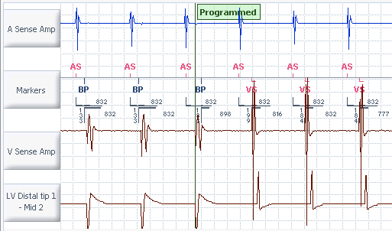
设置SyncAV™ CRT
第1步：自动测量自身传导时间：AS（或AP）-VS间期
SyncAV™ CRT程控需要确定恰当的起搏和感知AV延迟
需要3次连续AS（或AP）-VS事件
存储测量结果
Notes:
Let’s take a closer look at step 1 to SyncAV™ CRT setup.From the moment that the interrogation session begins, anytime that 3 consecutive A-sense, V-sense or A-pace, V-sense events occur the device will store the last of the intrinsic AV intervals measured.These measurements can and may occur even before the SyncAV™ CRT setup screen is opened such as during a ventricular sense test.
Measurement of the patient’s intrinsic AV conduction interval is necessary for the SyncAV™ CRT algorithm to determine the appropriate Paced and Sensed AV Delays.
Even though this step occurs automatically, there are some instances where the measurements may not occur automatically.We will review how to address that situation in a few slides.

Slide 10
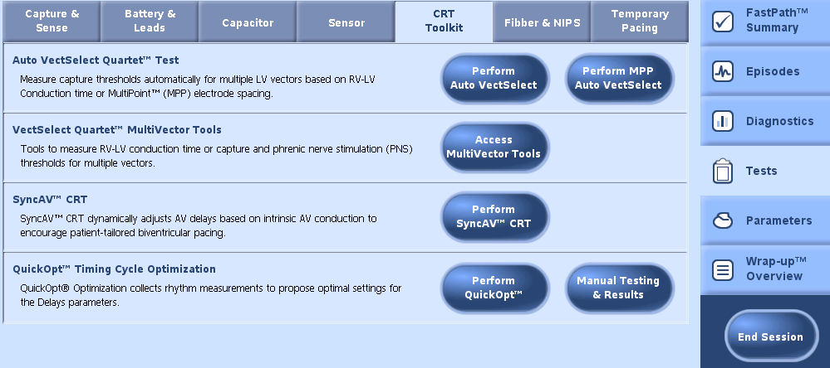
设置SyncAV™ CRT
第2步：转至CRT工具包，点击执行SyncAV™ CRT按钮
Notes:
The next step in the setup of SyncAV™ CRT is to navigate to CRT Toolkit and press Perform SyncAV™ CRT. This will open the SyncAV™ CRT parameters window.

Slide 11
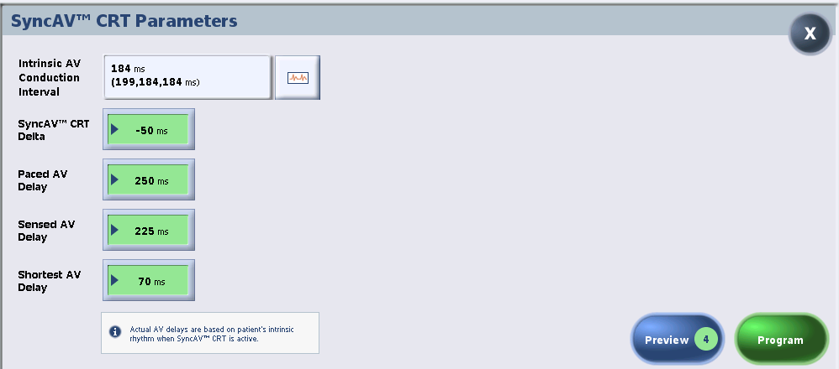
设置SyncAV™ CRT
第3步：回顾SyncAV™ CRT参数并程控启用SyncAV™ CRT。
Notes:
Step 3 in the setup of SyncAV™ CRT includes review of the parameters and then programming.
In the window that opens, the SyncAV™ CRT Parameters are displayed.
If the intrinsic AV conduction intervals were obtained automatically earlier in the session, they will be displayed along with the algorithms suggested settings for the Paced and Sensed AV Delays which is based on the measured Intrinsic AV Conduction Interval.
A frequently asked question:Why do my AV Delays have to be longer than the measured intrinsic value?
Answer:The Paced and Sensed AV Delays must be programmed longer than the measured intrinsic AV conduction intervals so that the SyncAV™ CRT algorithm can conduct a periodic measurement of the patient’s intrinsic conduction as changes occur.
The nominal SyncAV™ CRT delta is -50 ms and is programmable.
It is also important to note that the nominal value for the Shortest AV Delay is 70 ms, which may be shorter than some physicians prefer.
NOTE:The SyncAV™ CRT Delta can also be programmed from the Parameters workspace
Once you have reviewed the SyncAV™ CRT parameters, press the Program button to enable SyncAV™ CRT.

Slide 12
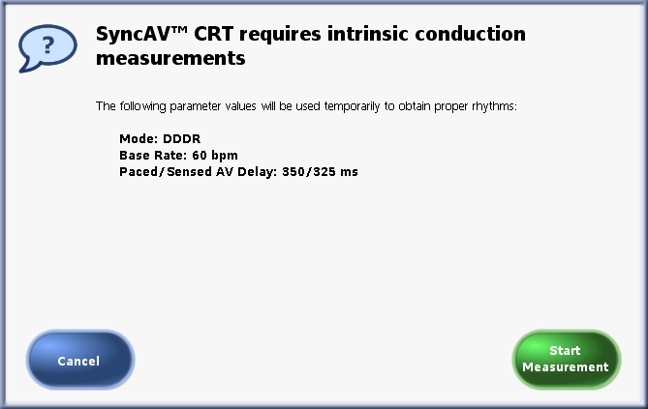
设置SyncAV™ CRT
Notes:
Earlier we discussed that the device will automatically measure the intrinsic AV conduction intervals anytime that 3 consecutive A-sense, V-sense or A-pace, V-sense events occur.In the chance that those measurements were not obtained prior to initiating SyncAV™ CRT setup the displayed message will appear.
The base rate shown is dependent on the permanently programmed base rate.Press Start Measurement to enable temporary program to obtain the intrinsic AV conduction intervals.The measurements will occur automatically and complete in less than 5 seconds.Upon completion the SyncAV™ CRT parameters window will be displayed.

Slide 13
程控注意事项和功能之间的相互影响
SyncAV™ CRT可用性
仅在跟踪模式DDD可用
SyncAV™ CRT和PVC
在发生PVC时SyncAV CRT不会缩短延迟，PVC定义如下：
没有心房事件的Vs事件
AV间期 < 100ms
最短的AV延迟
当启用SyncAV™ CRT时，最短的AV延迟在正常情况下设为70 ms。
频率适应性的AV延迟
当使用SyncAV™ CRT时，频率适应性AV延迟功能被关闭。
SyncAV™ CRT Delta
SyncAV™ CRT delta值可用于进一步改善CRT个性化、Bi-V融合和/或QRS改善，根据每个患者具体情况进行微调。
LV-RV间期
LV-RV间期设置需谨慎，尤其是需使用很长的间期时。因为目的是在对于自身传导作出反应，程控很长的间期可能导致右心室夺获功能性丧失，如果这就是实际目的，这可能有用。
心室自身优先（VIP™）算法
SyncAV™ CRT和心室自身优先（VIP™）算法无法同时启用
Notes:
Let’s take a moment and review programming considerations and interactions for SyncAV™ CRT
SyncAV™ CRT is only available in a tracking mode; DDD
SyncAV™ CRT does not shorten delays based on PVCs, which are defined as:
A V-sense event without a preceding atrial event, or
AV interval < 100ms
When enabling SyncAV™ CRT, the Shortest AV Delay nominally is set to 70ms.
Rate Responsive AV Delay is turned OFF when using SyncAV™ CRT
The SyncAV™ CRT delta can be used to further refine CRT individualization, Bi-V fusion and/or QRS improvement.This fine tuning would be need to done on a case by case basis.
LV-RV offsets are important to consider, especially when a larger offset is being used.Since the goal is to react to the intrinsic conduction, a large offset may cause functional loss of capture in the right ventricle.This may be useful if that is the actual goal.
And lastly, SyncAV™ CRT and the Ventricular Intrinsic Preference (VIP™) algorithm cannot be enabled at the same time

Slide 14
运行中的SyncAV™ CRT
工作原理
Notes:
Now that we have reviewed the simple steps to enable SyncAV™ CRT, let’s take a look at how the algorithm functions.

Slide 15
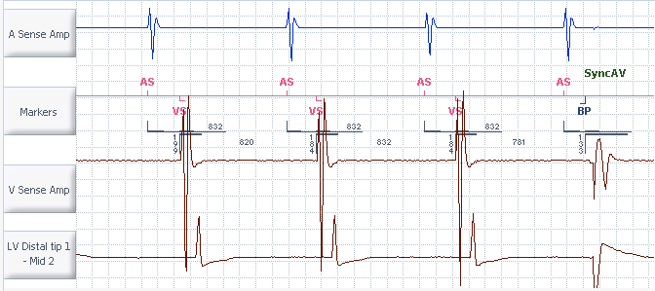
运行中的SyncAV™ CRT
每256个心动周期，AV延迟设为以程控的AV间期值搜索3个心动周期（以SAV=225 ms为例）
SyncAV CRT使用以下计算方式调整接下来256个心动周期的AV延迟： AV_{延迟} =（自身传导时间）-（SyncAV CRT Delta）
发生AV自身下传，SyncAV™ CRT测量这3个心动周期的传导间期
1
3
2
199 184 184
1
3
2
内在传导时间 = 184 ms
SyncAV™ CRT delta = -50 ms
AV_{延迟} w/SyncAV™ CRT = (184 – 50) = 134 ms
Notes:
Every 256 cycles the AV delay is set to the programmed value for 3 cycles (in this example 225 ms).Simultaneously, the AV conduction occurs intrinsically and SyncAV™ CRT measures the conduction interval for 3 cycles.In this example, 199, 184 and 184ms are measured.The 3rd interval is the one the device will use for calculating the new AV delay.
SyncAV CRT adjusts the AV delay for the next 256 cycles using the following equation: the AV Delay equals the (Intrinsic Conduction Time) minus the (SyncAV™ CRT Delta).
In this example the measured intrinsic conduction time was 184ms.The SyncAV™ CRT delta is programmed to -50ms.Subtracting 50ms from 184, we get 134ms.

Slide 16

SyncAV™ CRT：持续心律监测
心率（bpm） | 256个心动周期的时间（min）
50 | 5.1
60 | 4.3
70 | 3.7
80 | 3.2
90 | 2.8
256个心动周期
Notes:
SyncAV™ CRT provides continuous rhythm monitoring.Every 256 cycles the algorithm will re-evaluate the patients intrinsic conduction.Since the algorithm is based on a set number of cycles and not an interval of time, it is inversely proportional to the patients rate.As a result the 3 cycle search window will have little effect on bi-V pacing percentage.
Review the chart displayed.As the patients rate increases, the time required to reach the 256th cycle decreases.In contrast, as the patients heart rate slows, the time required to reach the 256th cycle, increases.

Slide 17
病例研究
根据患者活动程度的变化动态调整
Notes:
SyncAV™ CRT is a dynamic algorithm and it adjusts to changes in the patients conduction.Over the next few slides we will review a case study with example of the algorithm dynamically adjusting.

Slide 18

患者程控
患者休息
患者活动
患者略微活动
Notes:
SyncAV™ CRT responds to changes in a patient’s normal conduction as they go about their daily activities.Let’s take a look at an example of how the algorithm adapts to the patient’s changing intrinsic conduction throughout the day.

Slide 19
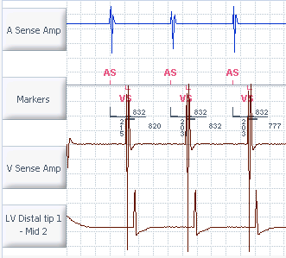
SyncAV™ CRT程控为打开
SyncAV™ CRT程控为打开
每256个心动周期，自动测量自身AV传导间期
SyncAV™ CRT delta根据实测自身AV间期 调整起搏/感知AV延迟
256
215
203
203
Notes:
In the clinic setting, after reviewing the parameters, SycnAV™ CRT can be enabled by the physician.If desired the physician can adjust the SyncAV™ CRT Delta to their preferred value.Once enabled, the device will continually search for intrinsic conduction every 256 cycles and adjust the Paced and Sensed AV delays by the SyncAV™ CRT delta.In this example, during SyncAV™ CRT setup, the patient’s intrinsic AV conduction was measured at 203 ms.

Slide 20
患者程控
患者休息
患者活动
患者略微活动
Notes:
After leaving the clinic with SyncAV™ CRT enabled, the patient’s intrinsic conduction is continuously monitored.In this example the patient returns home and relaxes.

Slide 21
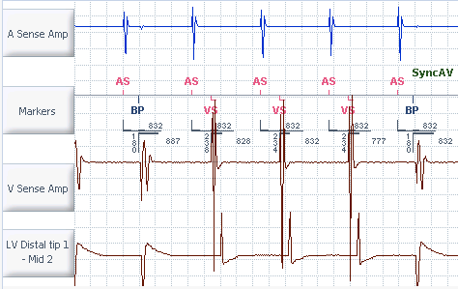
患者放松
每256个心动周期（约4分钟）， SyncAV™ CRT将暂时延长起搏/感知AV延迟至程控值，观察3次心跳以测量自身AV传导时间
该算法将基于第3个实测自身AV传导间期和已程控的SyncAV™ CRT Delta值来计算新的AV延迟
内在传导测量结果
238
234
234
Notes:
When the patient relaxes it is likely that their intrinsic conduction will slow.As a result, when SyncAV™ CRT searches for intrinsic AV conduction the algorithm will measure the longer AV interval and adjust the Paced and Sensed AV delays according to the SyncAV™ CRT delta.In this example the patient’s AV conduction interval is now measured at 234 ms.After subtracting the SyncAV™ CRT delta the new sensed AV delay is 180ms.This new delay will remain in effect for 256 cycles until the algorithm reevaluates the patient’s intrinsic conduction.

Slide 22
患者程控
患者休息
患者活动
患者略微活动
Notes:
Now let’s take a look at what happens when the patient becomes more active.

Slide 23
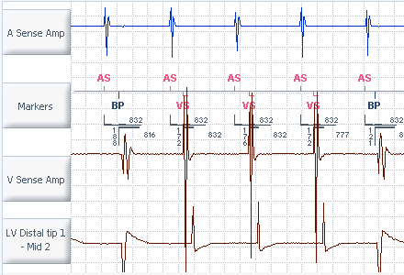
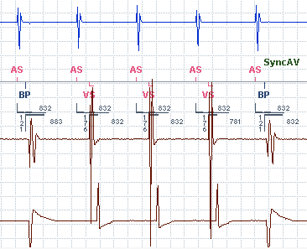
患者活动增加
自身AV传导缩短，发生VS事件
SyncAV™ CRT测量AV传导间期并缩短32个心动周期的AV延迟
在32个心动周期以后，AV延迟延长至起搏/感知AV延迟的程控值观察3个心跳
测量自身AV传导时间，运用SyncAV™ CRT delta值得到新的AV间期
使用缩短的AV延迟运作256个心动周期（约4分钟）直至算法再次动态调整
发生V-感知事件
内在传导测量结果
32个心动周期
256个心动周期
172
176
176
172
176
176
Notes:
As the patient’s activity increases, heart rate elevates and conduction through the AV node shortens.In the example shown here 3 spontaneous V-sense events occur.SyncAV™ CRT measures the AV interval and shortens the AV delay by the SyncAV™ CRT delta for 32 cycles.In this example, the measured intrinsic AV interval is 172 ms.After subtracting the SyncAV™ CRT delta the AV delay is set to 121 ms.
After 32 cycles the AV delay is extended to the programmed Paced/Sensed AV delay for 3 beats and the intrinsic AV conduction time is again measured.The SyncAV™ CRT delta is applied and the shortened AV delay is in effect for 256 cycles.
In the spontaneous case, the reason SyncAV™ CRT requires 3 consecutive A-sense, V-sense or A-pace, V-sense events is to avoid PVCs.When the device is searching the reason for requiring 3 is to allow for recovery of the AV node.

Slide 24
患者程控
患者休息
患者活动
患者略微活动
Notes:
Continuing with this example case study, the patient’s increased activity level has subsided and they are now in a less active state.

Slide 25
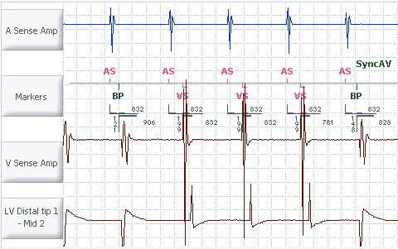
患者活动度减小
自身AV传导延长
在256个心动周期以后，AV延迟延长至起搏/感知AV延迟的程控值观察3次心跳
测量自身AV传导时间，运用SyncAV™ CRT delta值得到新的AV间期
256个心动周期（约4分钟）使用新的AV延迟直至算法再次动态调整
内在传导测量结果
256个心动周期
199
199
199
Notes:
When the patient’s activity level decreases their heart rate and conduction slow.On the 256th cycle, SyncAV™ CRT will extend the AV delay to the programmed Paced/Sensed AV delay values for 3 beats.In the example shown here the patient’s AV conduction time is 199 ms (compared to the previously measured 176ms).After applying the SyncAV™ CRT delta the resulting AV delay used for the subsequent 256 cycles is 148 ms.

Slide 26
根据患者心跳动态调整AV延迟
患者程控
患者休息
患者活动
患者略微活动
Notes:
SyncAV™ CRT allows for BiV pacing that is dynamically adapted to changes in the patient’s conduction as they go through daily life.

Slide 27
临床注意事项

Slide 28
应重点关注哪些患者？
SyncAV™ CRT与AdaptivCRT™算法的患者状况相似
SyncAV™ CRT | AdaptivCRT™
有自身AV传导 PR < 300ms 左束支传导阻滞 最小心室异位（PVC） 低AT/AF负荷 | 有自身AV传导 感知PR < 200ms/起搏PR < 250ms 左束支 心率< 100 bpm
SyncAV™ CRT预期不用于：
完全无1:1传导的心脏传导阻滞患者。
这些患者考虑使用QuickOpt™ AV优化。
Notes:
Similar patient profiles exists between the SyncAV ™ CRT and AdaptivCRT ™ algorithms.Take a moment and review the patient profiles displayed.
It is important to note that SyncAV™ CRT is not intended for patients with heart block where 1:1 conduction is not present all of the time.Consider using QuickOpt™ timing cycle optimization for these patients.

Slide 29
临床受益
AV和VV计时之间的关系⁶
与固定延迟相比动态AV计时
大范围的心率、AV传导时间和患者状态变化（即药物、活动程度等）可动态和自动调整
可缩窄QRS波或改善QRS波形态⁵
机制
在双心室融合起搏中，BiV起搏刺激的时间设置确保与自身右束支去极化达到一致⁶
已经证明此法可改善急性LV血流动力学反应^{1,2}、提高逆重构^{3,4}和缩短QRS波时限⁵。
RV/LV起搏融合
RBBc/RV起搏融合
RBBc/LV起搏融合
VV-间期
首先LV
AdaptivCRT™
RV
LV
同时
传统
CRT
SyncAV™
CRT
首先RV
短
内在
长
AV-延迟
LV起搏激活
RV起搏激活
RV起搏RBBc融合激活
RBBc激活（自身传导）
Notes:
The clinical benefit of dynamic A to V timing has been documented in publications and has shown the potential to narrow the QRS⁵.The mechanism by which this works is in biventricular fusion pacing, the BiV paced stimuli is timed to arrive coincident with the intrinsic right bundle branch depolarization.⁶

Slide 30
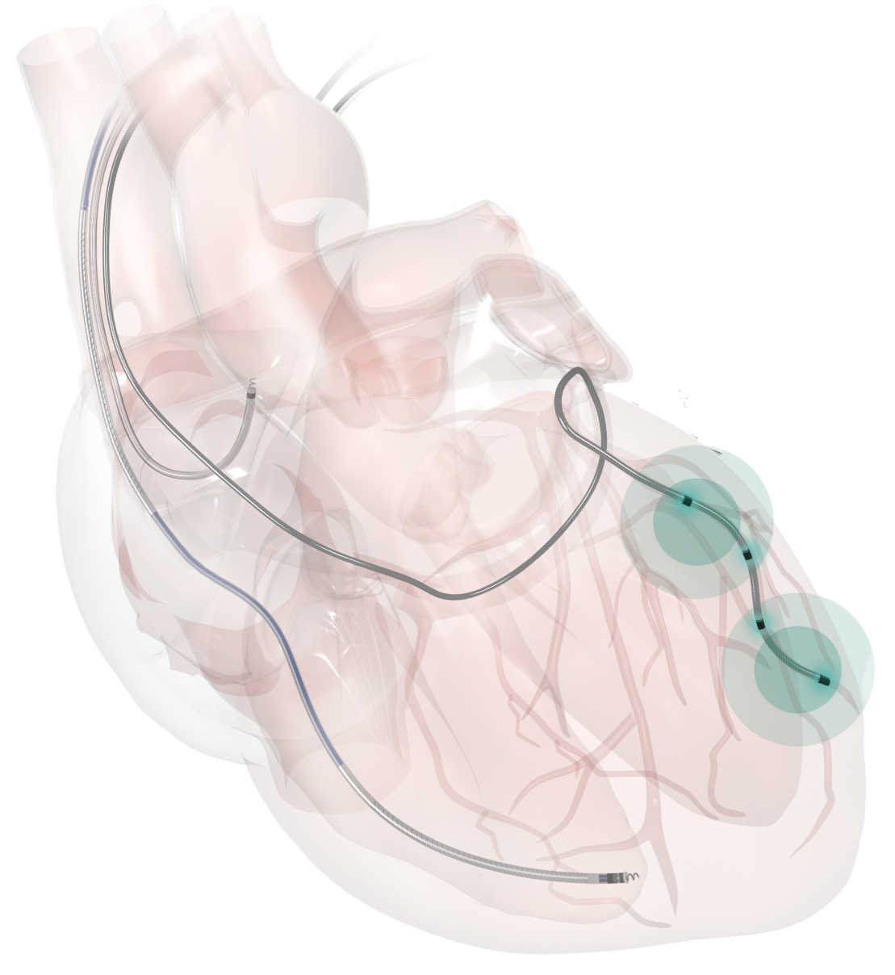
BiV起搏示例
LV
通过短AV延迟，双心室起搏完全替代自体激活（无RBB传导融合）。⁶
RV
Notes:
In the graphic depiction shown, when AV delays are short, biventricular pacing completely replaces native activation.

Slide 31
SyncAV™ CRT示例
AV结
LV
AV延迟= PR间期，RV起搏与内在传导同时发生导致RV起搏与融合相结合⁶
RV
Notes:
When the AV delay is equal to the PR interval, RV pacing occurs simultaneously with intrinsic conduction resulting in a combination of RV pacing and fusion⁶

Slide 32
定位与竞争
SyncAV™ CRT | 客户 | AdaptivCRT™算法
✔ | 适应性 | ✔
✔ | 易于使用 | ✔
✔ + MultiPoint™起搏 | 解决 无反应者 | ✔
 | 单一LV起搏 | ✔ 延长寿命
正在开展单一试验机构研究 即将开展多中心研究 | 临床经验 | 非劣效性研究 AdaptResponse试验
Notes:
Here is a comparison of SyncAV™ CRT to AdaptivCRT™ algorithm across several customer motivating factors.

Slide 33
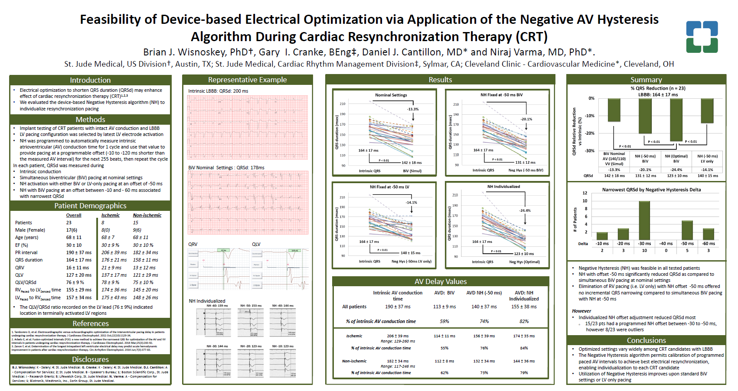
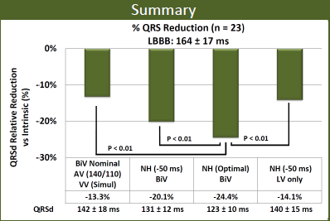
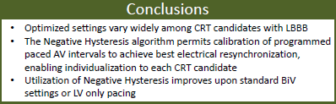
HRS摘要总结
心脏再同步治疗（CRT）期间通过应用AV负滞后算法获得的基于器械的电传导优化可行性
总结
总结
_{% QRS缩短（n = 23）}
_{LBBB：164 ± 17 ms}
%QRS减少（n=23）
LBBB：164±17ms
QRSd相对减少vs.内在（%）
_{QRSd相对缩短vs内在（%）}
BiV Nominal AV (140/110)
VV （同时）
NH (-50 ms) BiV
NH（最佳）BiV
NH (-50 ms)
单一LV
BiV标称AV（140/110）VV（模拟） | NH（-50ms） BiV | NH（最佳） BiV | NH（-50ms） 单一LV
结论
·具有LBBB的CRT入选者大部分优化设置值都不同
·负向AV滞后算法允许校准程控的起搏AV间期以实现最佳电再同步， 向每位CRT入选者提供个性化治疗
·使用负滞后能改善标准BiV设置或单一LV起搏
Notes:
During the 2016 Heart Rhythm Society’s scientific sessions a poster was presented on electrical optimization via application of the Negative AV Hysteresis algorithm.The group found that by using optimal Negative Hysteresis programming they we able to achieve reduction in QRS duration by 24% and that utilization of Negative Hysteresis improves upon standard BiV settings or LV only pacing.
It is important to remember that SyncAV™ CRT is an algorithm based on Negative Hysteresis.It functions the same, except now with a longer search window and when programmed with longer AV delays it allows for the device to measure the patients intrinsic AV conduction and adapt to changes in conduction.

Slide 34
预测寿命比较†
†寿命估计参数：
15%心房起搏
A/RV：2.0 V，0.4 ms
LV1/LV2：2.5 V，0.4 ms
频率：
MDT：15% @ 60 bpm和85% @ 70 bpm
SJM：68 bpm - 估计等同于MDT频率
带AdaptiveCRT™的Viv™ Quad XT CRT-D
50%单一LV
50%BiV
*Quadra Assura MP™ CRT-D Manual的Quadra Assura MP™ CRT-D数据
‡Medtronic Viva™ Quad XT CRT-D Manual的Viva™ Quad XT CRT-D数据
Notes:
Take a moment and review the projected longevity comparison.
If your physician is selecting a Medtronic device with AdaptivCRT™ for LV only pacing and the longevity, a strong argument can be made for choosing a St. Jude Medical Quardra Assura MP™ CRT-D programmed to BiV pacing, because there is an additional year of longevity.
Further, should the patient require it, MultiPoint™ pacing results in approximately a 2.5 month longevity impact.

Slide 35
参考文件
van Gelder BM, Bracke FA, Meijer A, Pijls NH.The hemodynamic effect of intrinsic conduction during left ventricular pacing as compared to biventricular pacing.J Am Coll Cardiol.2005 Dec 20;46(12):2305-10.
Verbeek XA, Auricchio A, Yu Y, Ding J, Pochet T, Vernooy K, Kramer A, Spinelli J, Prinzen FW.Tailoring cardiac resynchronization therapy using interventricular asynchrony.Validation of a simple model.Am J Physiol Heart Circ Physiol.2006 Mar;290(3):H968-77.
Vatasescu R, Berruezo A, Mont L, Tamborero D, Sitges M, Silva E, Tolosana JM, Vidal B, Andreu D, Brugada J. Midterm 'super-response' to cardiac resynchronization therapy by biventricular pacing with fusion: insights from electro-anatomical mapping.Europace.2009 Dec;11(12):1675-82.
Sweeney MO, Hellkamp AS, van Bommel RJ, Schalij MJ, Borleffs CJ, Bax JJ.QRS fusion complex analysis using wave interference to predict reverse remodeling during cardiac resynchronization therapy.Heart Rhythm.2014 May;11(5):806-13.
Arbelo E, Tolosana JM, Trucco E, Penela D, Borràs R, Doltra A, Andreu D, Aceña M, Berruezo A, Sitges M, Mansour F, Castel A, Matas M, Brugada J, Mont L. Fusion-optimized intervals (FOI): a new method to achieve the narrowest QRS for optimization of the AV and VV intervals in patients undergoing cardiac resynchronization therapy.J Cardiovasc Electrophysiol.2014 Mar;25(3):283-92.
Sweeny, M.O, Prinzen, F.W.(2008).Ventricular Pump Function and Pacing Physiological and Clinical Integration.Circ Arrhythmia Electrophysiology, (1), 127-139

